Slide 1
A Generalist EEG Foundation Model
One model · 4 to 64 channels · 17+ screening tasks · deployed via MCP
Neocog / BrainScope · internal + board review
Notes:
Open by framing the core claim: we have a single foundation model that generalizes across datasets, channel counts, and clinical questions. For board: this is the product and its traction story. For clinicians: this is what you will interact with through BrainScope. For researchers: this is the model and methodology we validated. The performance numbers shown later are from the v5 evaluation rerun on Apr 7 — the preceding eval runs unintentionally used v3_minimal data; the fixed numbers are slightly less flattering on TBI/MMSE but are the honest result.

Slide 2
Why EEG is underused in clinical screening
• EEG is cheap, non-invasive, and widely available — yet it is rarely used as a screening tool for neurological disease.
• Datasets are fragmented: different cohorts, different clinical labels, different electrode montages.
• Channel counts vary from 4 (portable bedside) to 64+ (hospital HD-EEG). Most ML models only accept a single, fixed montage.
• No shared representation means every clinical question starts from scratch.
• Result: narrow, over-fit classifiers that do not transfer — and no clear FDA-style evidence base.
Notes:
Set the problem for the mixed audience. For board: there is a real market gap here — EEG infrastructure already exists in every hospital, what is missing is an ML layer. For clinicians: acknowledge that current 'AI EEG' tools are mostly one-off, not generalist. For researchers: variable channel counts + small per-task datasets are the canonical roadblocks, and we have something to say about each.

Slide 3
Our solution: one encoder, many downstream tasks
• A single 29 M-parameter transformer encoder pretrained self-supervised on ~4,000 EEG recordings from 7 clinical cohorts.
• Handles variable channel counts end-to-end (4 → 64) via learned spatial coordinates and channel masking.
• Drives three complementary outputs from the same frozen embedding:
◦ 37 validated classifiers and regressors (XGBoost + TabPFN)
◦ Supervised fine-tuned (SFT) language-model pipeline that writes clinical narratives
◦ BrainScope MCP server that any Claude client can call directly
• No per-task model retraining. No per-device retraining.
Notes:
Give the whole picture in one slide so the rest of the talk has a mental map. Emphasize the word 'single' — a single pretraining run produced the encoder, and everything else is a thin adapter on top. This is the generalist claim.

Slide 4
Architecture — EEGEncoderV3
• 512-D transformer · 8 layers · 8 attention heads (GQA with 2 KV heads) · SwiGLU · RMSNorm · 8 register tokens.
• 29.4 million parameters — small enough to run inference on a single 16 GB GPU.
• Prefix-conditioned sequence: [experiment_token, condition_token, eeg_token, 8 register tokens, patch_1, ..., patch_N].
• Patch size = 32 samples (160 ms at 200 Hz). Spatial 2D RoPE on per-channel (x, y) scalp coordinates.
• Trained fully self-supervised on v5-normalized EEG (robust z-score per channel).
Notes:
For researchers: the architecture choices (GQA, SwiGLU, RMSNorm, registers, spatial RoPE) are standard modern-transformer hygiene — what is novel is the prefix + variable-channel spatial embedding, covered on the next slide.

Slide 5
Channel masking — train once, run on any montage
• Every sample carries its own channel_coords (x, y) and channel_mask. Padding channels are zeroed before patch embedding.
• VariableSpatialPatchEmbedding attends over only the active channels — no fixed-19 lookup table.
• Random channel dropout during training (prob 0.5, floor = 4 channels) teaches the model to tolerate missing electrodes.
• Result: the same weights serve READTBI (4 frontal channels), standard 19-channel 10-20, and DORTMUND (64 channels at 10-10) — no retraining.
• Inference pipeline accepts any montage: we look up coordinates from channel names or read them directly from the H5.
Notes:
This is the single most important technical differentiator. Competitor EEG models are almost always locked to a fixed montage. Explain that the random channel dropout is the reason the model works at 4 channels despite most training data being 19-channel — the model has been explicitly exposed to heavily sparsified inputs. For clinicians: this is why you can upload recordings from different devices and still get consistent results.

Slide 6
Condition tokens — the model sees the recording context
• Each (dataset, recording_state) pair gets a 2560-D text embedding from Qwen3.5-4B (e.g. 'AD_EEG | resting eyes closed').
• Cached in data/condition_embeddings.pt — 48 entries, one per dataset/condition combination.
• Projected to the encoder hidden dim and prepended as a prefix token.
• Lets the model disambiguate contexts that look superficially similar (eyes closed vs eyes open, resting vs task) without retraining.
• For uploads with unknown provenance the MCP server detects the dataset from H5 metadata or falls back to a generic resting-state embedding.
Notes:
This is the 'text grounding' trick. During pretraining the model learned to condition its own representations on the textual description of what the recording is. At inference, the BrainScope pipeline passes the detected recording context so the encoder behaves identically to how it was trained.

Slide 7
Self-supervised pretraining — no task labels required
• Next-patch prediction: MSE loss on the next raw 32-sample patch across all 19+ channels.
• Auxiliary feature prediction: smooth-L1 loss on 171 precomputed spectral features (5 band powers + 3 Hjorth + 1 variance per channel × 19 channels).
• Total loss = MSE(raw) + 0.1 · smooth_L1(features). Feature prediction acts as a regularizer — keeps representations physically meaningful.
• No downstream clinical labels ever touch pretraining. Every downstream benchmark uses patient-level held-out splits (next section).
Notes:
Pretraining was strictly self-supervised. The auxiliary spectral feature head is a small but important choice — it anchors the encoder to classical EEG quantities clinicians recognize (band powers, Hjorth parameters), which empirically helps downstream probes on small n.

Slide 8
Pretraining recipe
• Segment length = 120 s (24,000 samples at 200 Hz). Long-context training via n_concat (stitching consecutive segments).
• Augmentation stack: random channel dropout, random time shift (zero-padded, not circular), per-sample amplitude scaling.
• v5 preprocessing: per-channel robust z-score (median + MAD), clipped at ±6.
• Multi-GPU training with NCCL_P2P_DISABLE=1. Warmup + cosine LR, patience-200 early stopping, dropout=0.15.
• Best model: S_variable64_v6_r3 (Mar 2026) — the encoder shipped in BrainScope.
Notes:
Internal team knows this, but worth mentioning once for researchers and for future hires reading the deck. The augmentation stack and v5 preprocessing were the outputs of a lot of debugging — there is a long list of bug fixes in CLAUDE.md (val-loss all_reduce, warmup starting at LR=0, double channel dropout, zero-padded patches being predicted, etc.). All fixed before r3.

Slide 9
Datasets — 7 cohorts, ~4,000 recordings
ASZED excluded (5-second recordings, broken v5 processing).
Dataset | Recordings | Channels | Recording type | Clinical labels
AD_EEG | 88 | 19 | Eyes-closed resting | Alzheimer's vs healthy
CAUEEG | ~1,400 | 19 | Eyes-closed resting | AD, MCI, VaD, Parkinson's, healthy
DS004504 | 88 | 19 | Eyes-closed resting | AD, FTD, healthy
PEARL | ~100 | 19 | Resting + MSIT + Sternberg | APOE, BDI, RPM, 80+ clinical vars
TD_BRAIN | ~600 | 19 | Resting eyes open/closed | MDD, ADHD, sex, Tx response
READTBI | ~400 | 4 (Fp1/Fp2/F7/F8) | Portable bedside | TBI vs healthy
DORTMUND (ds005385) | ~3,200 | 64 (10-10 HD) | Eyes-closed / eyes-open resting | Age, sex (healthy cohort)
Notes:
This table is the data story. For board: this is how much raw EEG we own access rights to, spanning portable-device data (READTBI) through research-grade HD-EEG (DORTMUND). For clinicians: note the range of clinical questions covered. For researchers: the same foundation model is trained jointly on all 7, which is the whole point of the variable-channel architecture.

Slide 10
Train / test splitting — patient-level, no leakage
• Every patient is assigned to exactly one of two pools in master_patient_allocation.json:
◦ pretraining pool — may appear in train/val only
◦ held-out pool — may appear in test only
• Pools are disjoint across all 37 downstream task splits. A patient who appears in the AD test split is never seen during pretraining, never seen in the AD train split, and never seen in the test split of any other task they would leak to.
• scripts/validate_eval_setup.py audits the entire split graph before every eval — zero patient overlap confirmed.
• No within-patient train/test splitting of recordings — patient identity is the atomic unit.
Notes:
Leakage is the usual killer in small clinical ML datasets. For board/clinicians: this is how we guarantee that our AUCs are not inflated by the model memorizing patients. For researchers: the pretraining-pool vs held-out-pool separation is stricter than most published EEG benchmarks. There is one documented exception — treatment_response_balanced — where patients from the pretraining pool are reused, but only for linear probes on the frozen encoder (the encoder never saw labels). Everything else is airtight.

Slide 11
Parts vs whole — how we train and how we evaluate
• Training: each gradient step uses a 120-second segment sampled from a longer recording (optionally n_concat stitched segments for long-context). This gives the model many diverse views per patient.
• Evaluation: we use the ENTIRE recording. Segments are concatenated end-to-end, passed through the encoder in 1500-patch chunks, and every patch hidden state is mean-pooled into a single 512-D vector per file.
• Per-patient prediction = mean of all per-file embeddings, then one classification / regression call.
• Mean pooling beats last-token pooling on 11/15 classification tasks in our sweep — the model is not a causal summarizer, every patch carries signal.
• Segment-level evaluation (cheaper, more samples per patient) was the early default but produced systematically worse AUCs — full-recording eval is the reported protocol.
Notes:
This answers the 'parts vs whole' question directly. Clinicians sometimes ask whether we evaluate on 10-second windows or whole sessions — whole sessions, always. Researchers: last-token pooling is the obvious baseline given the causal transformer decoder, and the fact that mean wins is worth noting — it says that useful signal is distributed across the whole recording, not concentrated at the end.

Slide 12
Classifiers on top of the frozen encoder
• XGBoost (depth 4, 100 trees) and TabPFN (PCA → 128 dims) are fit on the 512-D embeddings for every task.
• Per task we keep whichever of the two has higher AUC on the held-out patients.
• The same fitted classifier objects that produced the reported AUCs are the ones shipped in the MCP server — no refitting. This fixed an earlier reproducibility bug where independently refit TabPFN instances gave different per-patient probabilities with the same AUC.
• TabPFN wins on tasks with small n and clean signal (vascular dementia, AD_EEG). XGBoost wins on tasks with structured noise or larger n (TBI resplit, differential diagnosis tasks).
• Encoder is never fine-tuned — only the ~10-1000 parameter head changes per task.
Notes:
This is a subtle but important slide. TabPFN is a non-standard choice and worth explaining: it is a pretrained in-context learner that is strong with small n, but it has calibration quirks between separate fit() calls. We saved the exact fitted objects from the eval run so the probabilities the MCP returns at inference are the same numbers the user sees in the paper figures. This is also why the MCP deployment needs torch/sklearn/tabpfn versions pinned.

Slide 13
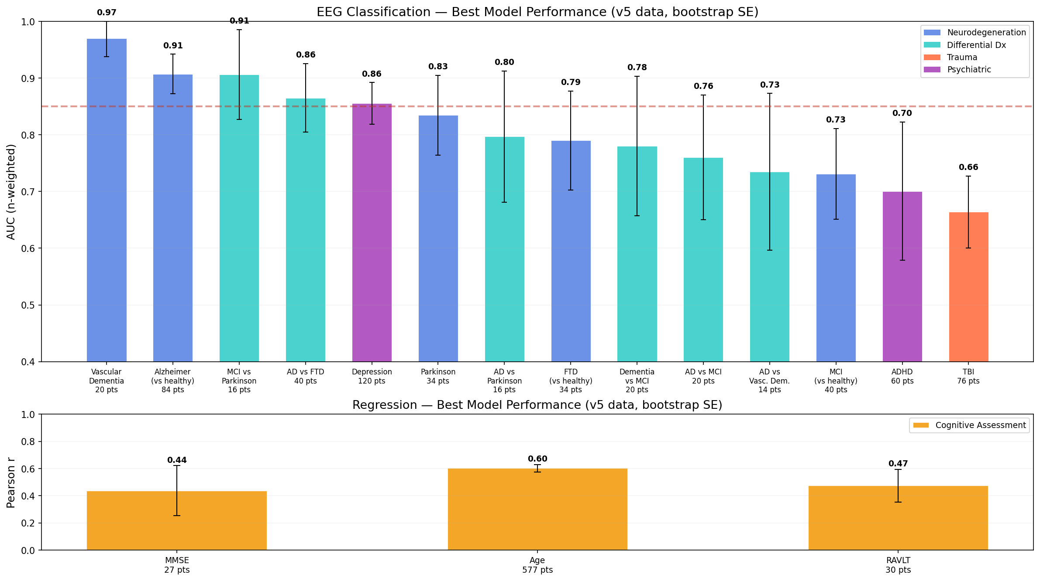
Classification performance across 14 indications
v5 data · bootstrap SE, 2000 resamples · red dashed line = FDA 0.85 threshold
Notes:
Top panel: 14 classification categories, color-coded by indication type (blue = neurodegeneration, teal = differential diagnosis, coral = trauma, purple = psychiatric). Bottom panel: regression tasks (MMSE, Age, RAVLT), next slide covers that. Five categories above the 0.85 FDA threshold: Vascular Dementia (0.97), Alzheimer's vs healthy (0.91), MCI vs Parkinson (0.91), AD vs FTD (0.86), Depression (0.86). Error bars are bootstrap SE over patients. The spread across error bars tells you which claims are solid vs marginal. For board: five indications above FDA ROC threshold is the key metric. For clinicians: the AUCs for cognitive decline screening (AD and VaD) are the highest-confidence cells.

Slide 14
Regression tasks — cognitive and biological markers
• Brain age from EEG: r = 0.60 (n = 577, SE < 0.03). Tight because we pool three age-labeled cohorts (DS004504, DORTMUND, SRM).
• MMSE prediction: r = 0.44 on n = 27 (DS004504 only, wider SE). Direction correct, precision limited by sample size.
• RAVLT total recall (verbal memory): r = 0.47 on n = 30 (SRM). Matches published feature-based baselines.
• Regression head is the same frozen encoder + XGBoost — no additional training complexity.
• Brain-age-gap (predicted minus chronological) is a validated biomarker for accelerated aging; we expose this as part of the BrainScope clinical output.
Notes:
Regression is underrated clinically. Brain-age-gap gives a single continuous score that summarizes 'does this EEG look older than the patient is?' Research audience: the brain age correlation is competitive with published EEG foundation model results and we get it with a 29 M parameter model.

Slide 15
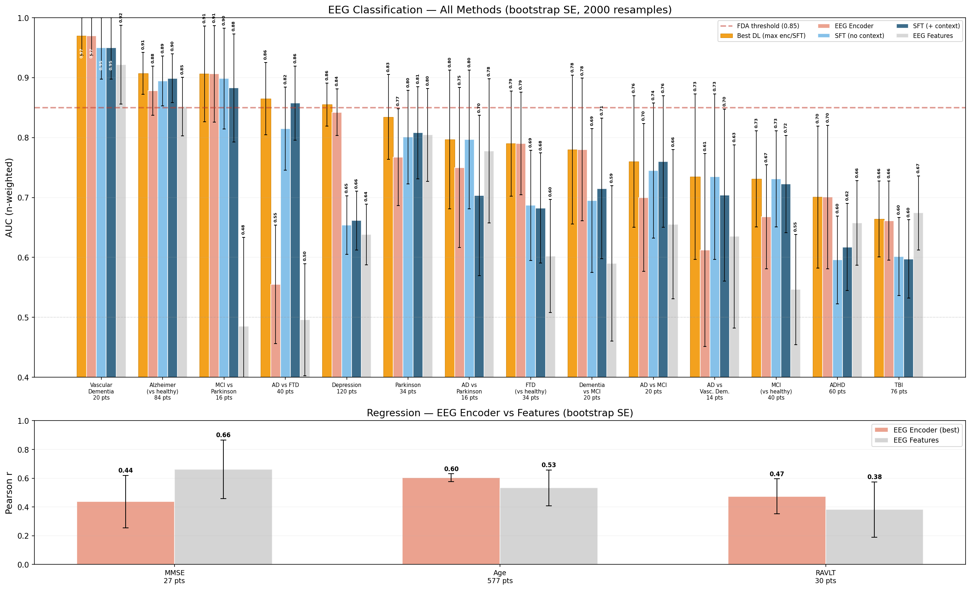
Methods comparison — encoder, SFT, and classical features baseline
Best DL (gold) wins 13/14 classification categories over hand-crafted features (grey)
Notes:
Gold bars = Best DL (max of encoder and SFT variants per task). Coral = encoder only. Light blue = SFT no context. Dark blue = SFT with clinical context. Grey = traditional EEG features baseline (band powers, Hjorth, spectral ratios + XGBoost). Two reads: (1) the encoder beats the features baseline on every category except ADHD; (2) SFT with context gives incremental gains on AD tasks but is flat on most others. For clinicians: the features baseline is what a neurologist would construct by hand — we beat it by a wide margin on AD, vascular dementia, MCI-vs-PD, and AD-vs-FTD discrimination.

Slide 16
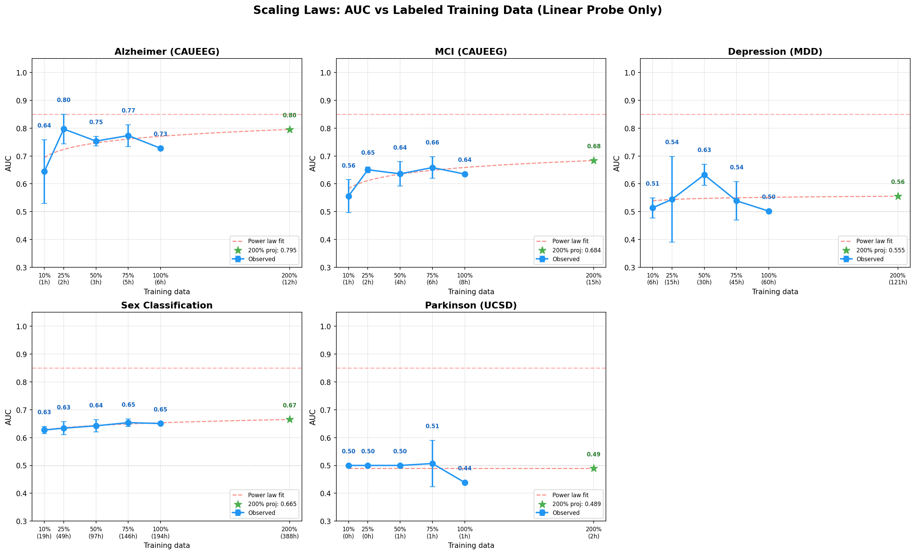
Does variable-channel training hurt 19-channel performance?
No — S_variable64 ≈ S_fixed19 on 19-ch tasks, and wins on DORTMUND where 64-ch is available
Notes:
The fear with variable-channel training is that it trades 19-channel performance for the ability to handle 4 and 64 channels. This figure shows that is not the case — the S_variable64 model matches S_fixed19 on the 19-channel benchmarks and strictly improves on DORTMUND (where 64 channels are actually available). This is the empirical justification for running the variable-channel encoder in production.

Slide 17
SFT pipeline — turning EEG embeddings into clinical language
• Frozen EEG encoder → mean-pool over patches → single 512-D vector per recording.
• Adapter: Linear(1024, 8 × 2560) + GELU + LayerNorm → 8 tokens injected into Qwen3.5-4B via masked_scatter at <eeg_token> positions.
• Stage 1: adapter only (≈5 M params). Stage 2: adapter + LoRA (r = 32) on the Qwen language model (≈25 M extra).
• Training data: 4,471 (file, task) pairs with clinician-style Q/A, label normalization, vacuous-EEG stripping, and regression-answer cleanup.
• Inference: greedy decode with enable_thinking=False (HF generate() is broken with inputs_embeds + EOS — we use a manual decode loop).
Notes:
Researchers care about the architecture here. The adapter is extremely small — 5 M params on top of a 29 M encoder and a 4 B LM — yet it is enough to produce coherent, clinically hedged output. Stage 2 LoRA is optional but sometimes helps. The inference fix (manual greedy decode) is a small implementation detail but was required to get stable output. Board/clinicians: the big idea is that the same embedding that drives the classifiers also drives the language model, so the narrative and the numbers are drawn from one shared representation.

Slide 18
SFT results — LLM output beats encoder linear probe on AD
Mean SFT accuracy 0.695 across this task set — best precomputed full-recording embeddings, all-context, random subset training.
Task | SFT accuracy | Encoder AUC | SFT wins?
Alzheimer's (AD_EEG) | 0.85 | 0.80 | Yes
Alzheimer's (CAUEEG) | 0.77 | 0.74 | Yes
Alzheimer's (DS004504) | 0.85 | 0.81 | Yes
Mild Cognitive Impairment | 0.65 | 0.56 | Yes
Vascular Dementia | 0.85 | 0.83 | Yes
Parkinson's (CAUEEG) | 0.75 | 0.83 | No
Parkinson's (UCSD) | 0.50 | 0.61 | No
Frontotemporal Dementia | 0.50 | 0.67 | No
TBI | 0.53 | 0.69 | No
Notes:
For board: SFT delivers same-or-better performance as the encoder linear probe on the AD family — which is where our strongest data sits. For clinicians: the LLM output is not a replacement for the classifier probability — it is a narrative *built on top of* the classifier output plus literature. We do not rely on the LM's raw clinical opinion. For researchers: the cases where SFT is worse (Parkinson's, FTD, TBI) are also the cases with the smallest or most channel-limited data, consistent with the LM overfitting noise.

Slide 19
BrainScope MCP — plugging the encoder into any Claude client
• MCP (Model Context Protocol) is Anthropic's standard for exposing tools to a language model.
• BrainScope is an MCP server that ships 30+ tools — one per condition — that any Claude client (Desktop, claude.ai) can call directly.
• Tool set includes: get_recording_info, run_all_screens, screen_<condition>, run_baseline_screens (features comparison), search_literature, get_model_card.
• The LM reasons about which tools to call based on the user's question (e.g. 'screen for cognitive decline' triggers AD, MCI, VaD, FTD, and the age/MMSE regressors).
• Deployed remote SSE server on RunPod — users add 4 lines to their Claude Desktop config, no local install required.
Notes:
Board: MCP is how we get our model into the hands of downstream users without building our own UI from scratch. Clinicians: you interact with BrainScope by talking to Claude as usual — upload an EEG, ask a clinical question, get a report. Researchers: the MCP surface is the one-stop public API — every classifier, every regression head, and the SFT narrative are all exposed.

Slide 20
BrainScope workflow — upload to clinical report
• Step 1 — upload: user drops an EDF or H5 file at the upload URL, gets back an upload_id.
• Step 2 — encode: preprocess_eeg runs robust z-score + channel mapping; encoder produces a 512-D embedding (cached per upload_id).
• Step 3 — screen: run_all_screens evaluates every classifier in parallel; also runs the traditional-features baseline for comparison.
• Step 4 — literature: search_literature pulls curated EEG/neurology references for any flagged conditions.
• Step 5 — synthesize: the LM writes an OpenEvidence-style report with inline citations, clinical context, suggested next steps, and a limitations disclaimer.
• End-to-end latency: ~1-2 seconds on a single modern GPU.
Notes:
Walk through the steps one by one. Note that the encoder runs once per upload and is cached — subsequent screenings of the same file are near-instantaneous. The 'synthesize' step is what makes this feel like OpenEvidence: Claude builds a clinical narrative grounded in classifier output, literature citations, and appropriate hedging language.

Slide 21
Walkthrough — an AD-positive patient and a healthy control
• Prompt (AD case): 'I'm a 78-year-old woman. My family says I keep repeating the same stories and I got lost driving home from the grocery store last week. My doctor is concerned about Alzheimer's.'
• BrainScope output on ad_positive_strong.h5: AD (AD_EEG classifier) = 0.95 · AD (CAUEEG) = 0.96 · AD vs FTD = 0.95 · Vascular Dementia = 0.46 · predicted MMSE = 21
• Healthy-control prompt: 'I'm 68, feeling sharp, annual wellness check.'
• BrainScope output on healthy_clear.h5: AD (AD_EEG) = 0.05 · Vascular Dementia = 0.48 · predicted MMSE = 28
• Both cases: an auto-generated clinical report with citations, next-step recommendations, and a never-diagnose disclaimer.
Notes:
These are two of the 8 test recordings in tf_records/test_bs/ — they are from actual AD patients and age-matched controls in the AD_EEG dataset. The probabilities shown are what the deployed MCP returns (the v5-fitted classifiers). The contrast (0.95 vs 0.05 on AD_EEG) is the cleanest demonstration that the pipeline works per-patient, not just on aggregate AUC.

Slide 22
Limitations and roadmap
• Screening tool, not diagnostic. Every output hedges with 'findings consistent with' / 'may warrant further evaluation'.
• Test-set sizes are small for some conditions (n = 14-40). Error bars on the performance plots reflect this.
• Not evaluated by FDA, CE, or any regulatory body. De Novo pathway would be the natural route for clinical deployment.
• Known weak cases: TBI (4-channel portable data is under-resourced), Parkinson's UCSD (small n), pure psychiatric screening (ADHD, mood).
• Near-term roadmap:
◦ expand the condition library (targeted acquisition of under-represented cohorts)
◦ condition-agnostic fallback for unknown dataset provenance
◦ real-time streaming for continuous monitoring use cases
◦ regulatory pathway planning (FDA De Novo vs 510(k) Clinical Decision Support exemption)
Notes:
Board: this is the 'where we go next' slide. The regulatory point is important — we are clearly in Clinical Decision Support territory, not a diagnostic device, which opens the 21st Century Cures Act exemption as a plausible low-friction route. Clinicians: acknowledge limitations honestly — small n, narrow clinical validation, no formal regulatory review yet.

Slide 23
Summary
• One generalist 29 M-parameter encoder handles 4 → 64 channel recordings from 7 clinical cohorts.
• 17+ validated downstream tasks — 5 above the FDA 0.85 AUC threshold (Vascular Dementia, Alzheimer's, MCI vs PD, AD vs FTD, Depression).
• Same frozen embedding drives classifiers, regression heads, and a Qwen3.5 language-model pipeline that writes clinical reports.
• Deployed as a remote MCP server (BrainScope) — any Claude client is a BrainScope client with 4 lines of config.
• Strict patient-level evaluation, no train/test leakage, bootstrap error bars on every reported AUC.
• Next: more conditions, regulatory pathway, real-time streaming.
Notes:
Closing slide. Hit the four audience angles one last time: generalist model (researcher), FDA-threshold performance (board), deployed Claude interface (clinician), and honest methodology (internal/reviewers). Q&A from here.

